Slide 1

Chengdu University of Technology
Computer Science and Technology
Product
Comparison System
Speaker： Darren（Zhu Xunran）
Mentor： Albert Xu

Slide 2
CONTENTS
01
Introduction
02
Motivation
03
Background Review
CONTENTS
04
Methodology
05
Project Implementation &Results
06
Conclusion

Slide 3

PART 01
Introduction

Slide 4

Introduction
Background
With the gradual rise of Internet technology, people's lifestyles and shopping habits have changed and online shopping has become increasingly popular. People are keen to compare prices on products when shopping online. A price comparison system that can display matching products from multiple shopping platforms and display product information and price comparison results after users enter relevant search terms would provide great convenience to users. How to implement this price comparison system to improve the convenience of consumer shopping has become the focus of the moment.

Slide 5
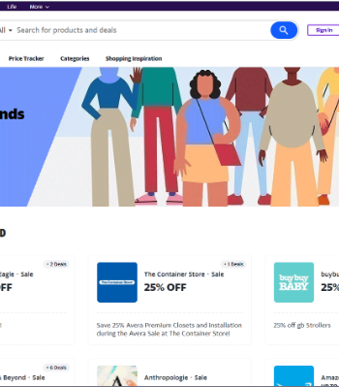
Introduction
Aim
Using a data extraction method based on web and web crawler technology, we designed a system that can compare prices of products on different platforms to meet consumers' needs for online shopping comparison.
Objectives
1)Background research 2) Determination of development steps
3) Database design 4) Crawler technology design
5) Front-end UI design 6) Back-end code design
7) Test project 8)Realization project

Slide 6
PART 02
Motivation

Slide 7



Motivation
Purpose of topic selection
What is the problem
Why is it interesting

Slide 8
PART 03
Background Review

Slide 9

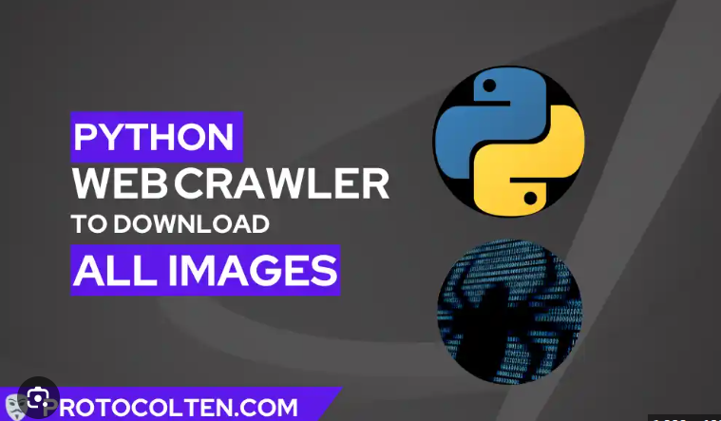
Background Review
Literature Research
Find literature on price comparison systems and study the development ideas in the literature.
Technology Research
Crawling technologies: Scrapy, Pyspider, and Beautiful Soup, etc.
Front-end technologies: HTML5
Database technologies: MySQL, SQL Server, Oracle, etc.
Back-end coding technologies: Python, Java

Slide 10
PART 04
Methodology

Slide 11
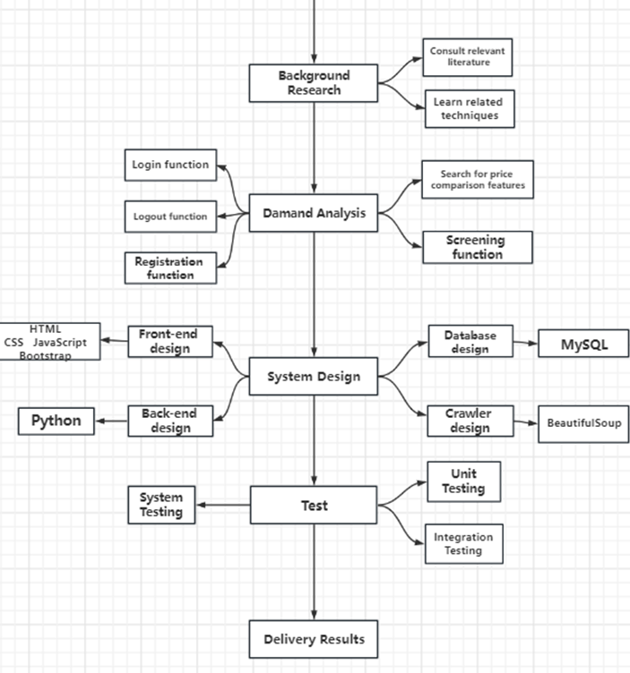
Methodology
Design Methodology
Front-end design: HTML5, JavaScript, CSS, Bootstrap framework
Back-end design: Python, Flask framework
Crawler design: BeautifulSoup, Selenium, Requests
Database design: MySQL

Slide 12
Methodology
Development tools used
Software: PyCharm 2021.2.3 , MySQL Workbench 8.0 CE, MySQL 8.0 Command Line Client
Hardware: CPU: Intel(R) Core (TM) i7-8565U CPU @ 1.80GHz 1.99 GHz
GPU: Intel(R) UHD Graphics 620, NVDIA GeForce MX250
Programming language: Python3.9, SQL, HTML
Browser: Microsoft Edge
Database: MySQL Database
Frame: Flask

Slide 13
PART 05
Project Implementation &Results

Slide 14

Project Implementation &Results
Design Process
1) Front-end design: firstly design the registration and login interface, secondly design the main interface of the system, including the main interface button, filter button and price comparison button, and finally design the price comparison interface.
2) Crawler design: first determine the crawl target and import the appropriate library, such as requests, selenium, beautiful soup and so on. Then send http request, next parse the web page to crawl and collect the data, and finally import the data into the database and save it.
3) Database design: first of all, requirements analysis, and then need to create two tables, one for saving the user's account password, the other is to save the crawled commodity data information, in the process of creating tables to pay attention to data types, constraints (primary key, unique constraints, etc.), and finally use SQL statements to write data for testing whether the database can run properly.
4) Back-end design: Based on Python language, set up routes to connect the front and back ends together to achieve front and back-end interaction. Connect the database, write the information crawled by the web crawler into the database, and finally present the data in the front-end interface to realize the price comparison function.

Slide 15
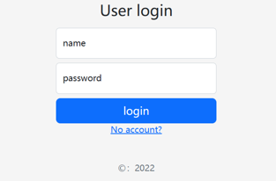
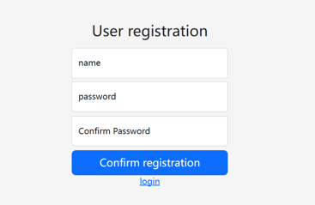
Project Implementation &Results
Results
Login
Registration

Slide 16
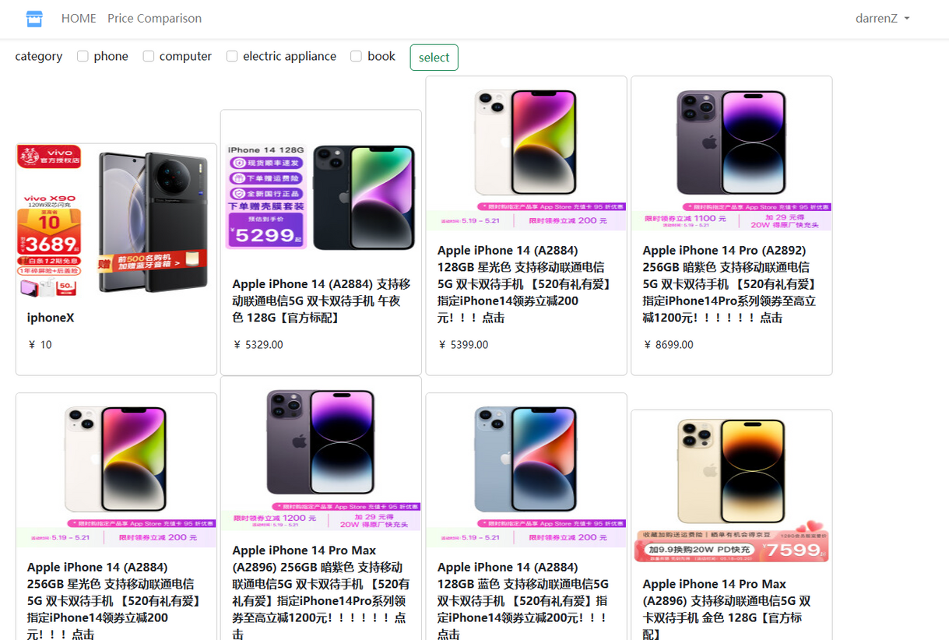
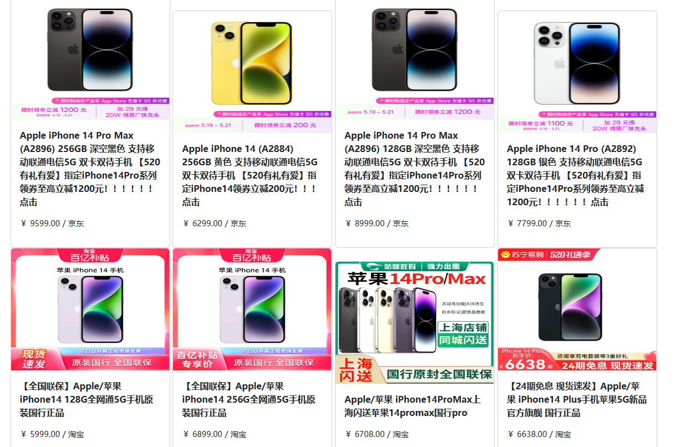
Project Implementation &Results
Results
Main Interface
Price Comparison Interface

Slide 17
PART 06
Conclusion

Slide 18
Conclusion
Overall, the project uses Python as the development language, Beautiful Soup as the crawler framework, MySQL as the database, Flask as the back-end framework, and Bootstrap as the front-end framework. Each part is linked by the back-end code on PyCharm compiler, which finally forms a complete price comparison system, and the basic functions have been implemented to meet the development design requirements and achieve the expected purpose.

Slide 19
Q & A
Please ask
your questions
Speaker：Darren（Zhu Xunran）
Mentor： Albert Xu

